Slide 1

The essence of machine learning for linguists in tech
Marie Berthouzoz

Slide 2
Presentation plan
Introduction, reasoning, goals
How to use the guide
Structure of a chapter
Brief overview of the content

Slide 3
Introduction, reasoning, goals
Goal: understanding the core notions of machine learning
Not a course, but a guide!
  aggregates carefully curated (correct, well-made, easy to understand) resources
  complements them with links and tips
Prerequisite: Start programming with Python in 10 steps (or equivalent)

Slide 4
How to use the guide
Intended for supervised learning
  Students 80%
  Teachers 20% (provide answers to some exercises + answers to questions)
10 chapters covering 10 topics, building on each other, of various lengths
for a total of 5 ECTS

Slide 5
Structure of a chapter
Introduction: What is the topic? Why is it relevant?
“Things to know”
Learn actively: External resources, connected in a way that makes sense

Slide 6
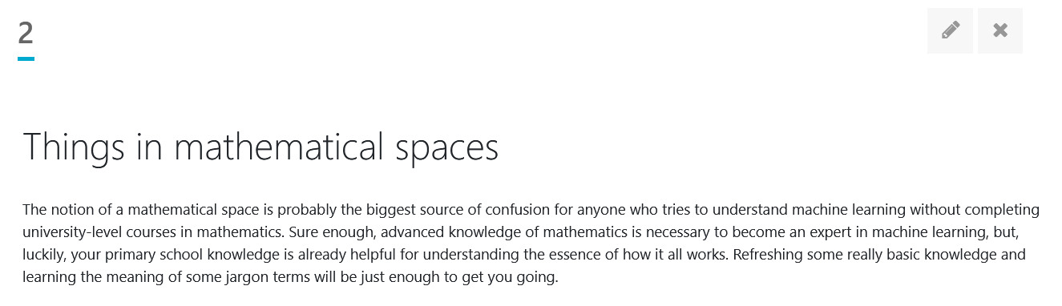
Structure of a chapter - Introduction

Slide 7
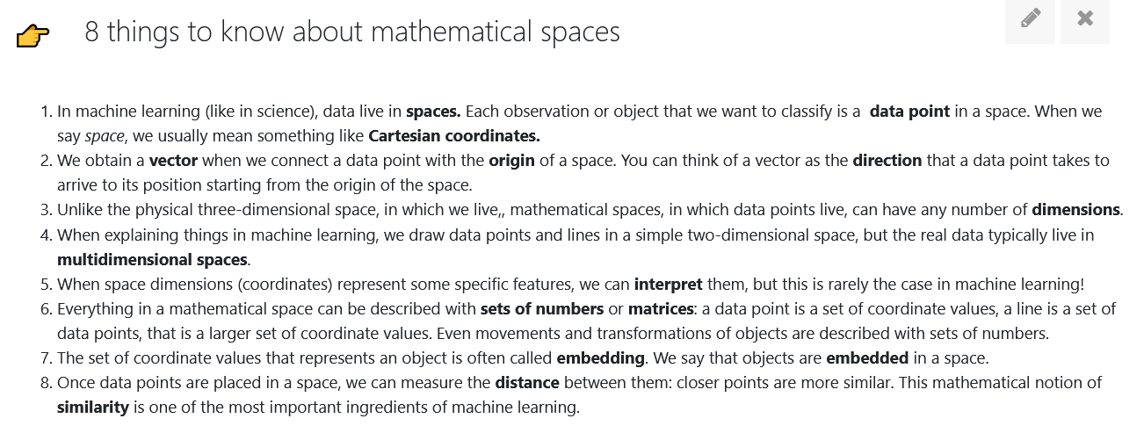
Structure of a chapter - Things to know

Slide 8
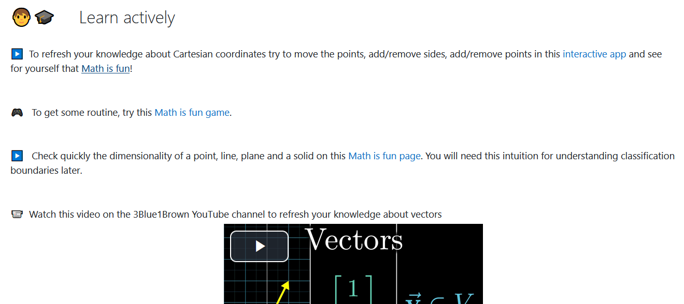
Structure of a chapter - Learn actively

Slide 9
Intended workflow
Introduction
Things to know
Learn actively

Slide 10
Brief overview of the content (1)
Machine learning needs linguists
Things in mathematical spaces
Data points need labels
Setting boundaries with the perceptron algorithm
Linguists need neural networks

Slide 11
Brief overview of the content (2)
Meanings are vectors
Learning meanings with (large) language models
NLP tasks for happy users
How good is an NLP model?
The practice and ethics of large language models (LLMs)

Slide 12
Brought to you by
Tanja Samardžić
Marie Berthouzoz
Marc Tanti
Lonneke Van der Plas
Thank you!

