Slide 1

Upskilling your “Introduction to Language variation” course
A Moodle block created by Margherita Pallottino, Genoveva Puskas & Marie Berthouzoz

Slide 2
Roadmap:
The UPSKILLS mission
Why and how to upskill your course
Structure of the learning block
Unit 1 in detail

Slide 3
The UPSKILLS mission
Employment prospects for graduates in language-related disciplines are mainly restricted to teaching or translating.
This stands in contrast with their potential employability given the omnipresence of language and communication in society.
The central goal of the UPSKILLS project is to tackle these skills gaps through the development of new curricula components

Slide 4

Why did adopt this approach?
University curricula tend to be stiff and hardly adaptable to a rapidly changing job market
We believe that humanities are indispensable for a better society
Plus, the ability to think in theoretical terms is a highly valued skill…

Slide 5
To think in theoretical terms means:
Learn/discuss/discover a problem, abstracting away from its individual instances
Build up a framework/the best framework in which the problem will be solved
Learn to generalize over individual cases
View a given problem from various perspectives
Propose coherent solutions, with predictions on what new instances might look like
These are the skills that employers look for!

Slide 6
How to upgrade the skills of language and linguistics students (including BA level classes)
Design learning activities which make the student to reflect on the task they are given
Design learning activities which familiarize the students with the occupation’s typical activities and interactions
Define learning outcomes connect the educational process and the needs of the job market
Make the teaching materials engaging for instance by using gamification, or game based learning

Slide 7
Introduction to Language variation
Collect linguistic data
Organize and annotate the data
Confront the data with a theory (analyze)
Compare analyses/theoretical approaches
Interact minimally with programming
Elaborate a report of the research activities
The concept of language variation
The basic principles of Generative Grammar

Slide 8
Structure of the bloc:
The bloc targets BA students and is designed to be taught in class.
The bloc is constructed around the theoretical and practical learning goals distributed within 4 topics corresponding to 6 ECTS.
The bloc follows a modular approach:
  It consists of one introductory topic (topic 1 - propaedeutic) and three content topics that can be proposed independently from one another.
  Topics 1 - 3 revolve around the game “Guess the langauge!”
  Topic 4 can be adopted as stand-alone student project.

Slide 9
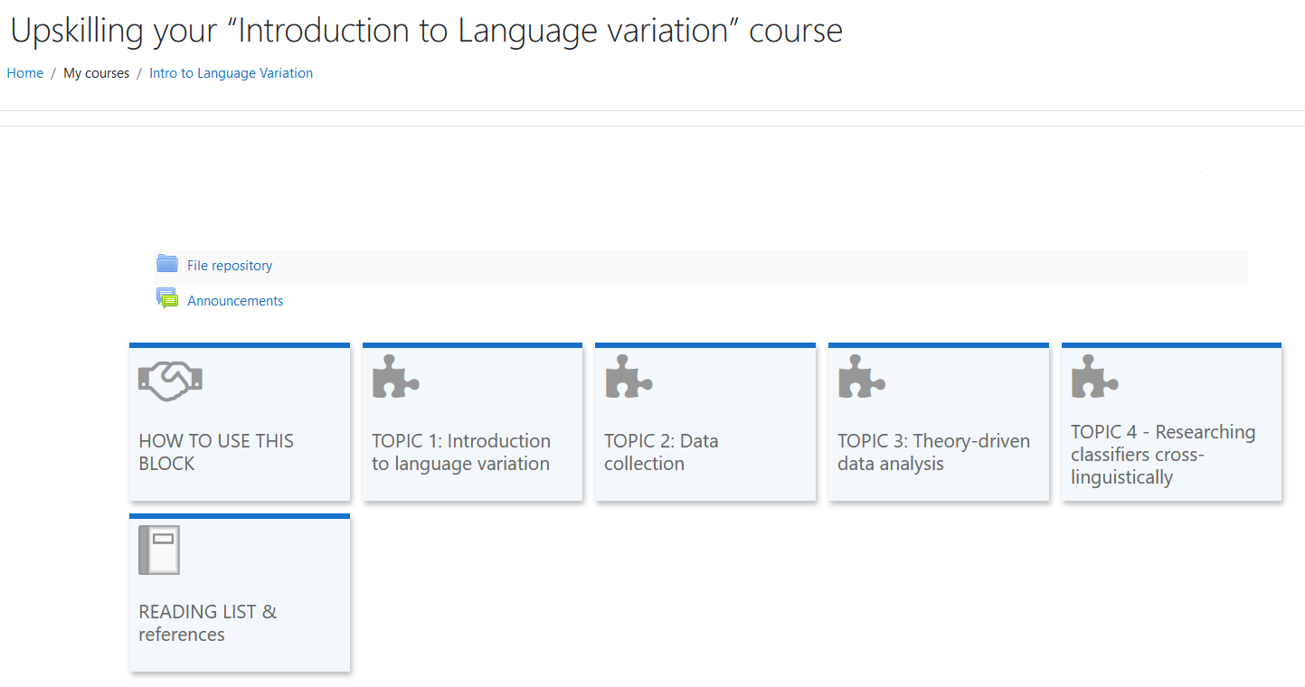

Slide 10
Structure of a topic
  Summary of the content
  Clear student/teacher workload
  Prerequisites
  Classes
  Revision activities

Slide 11
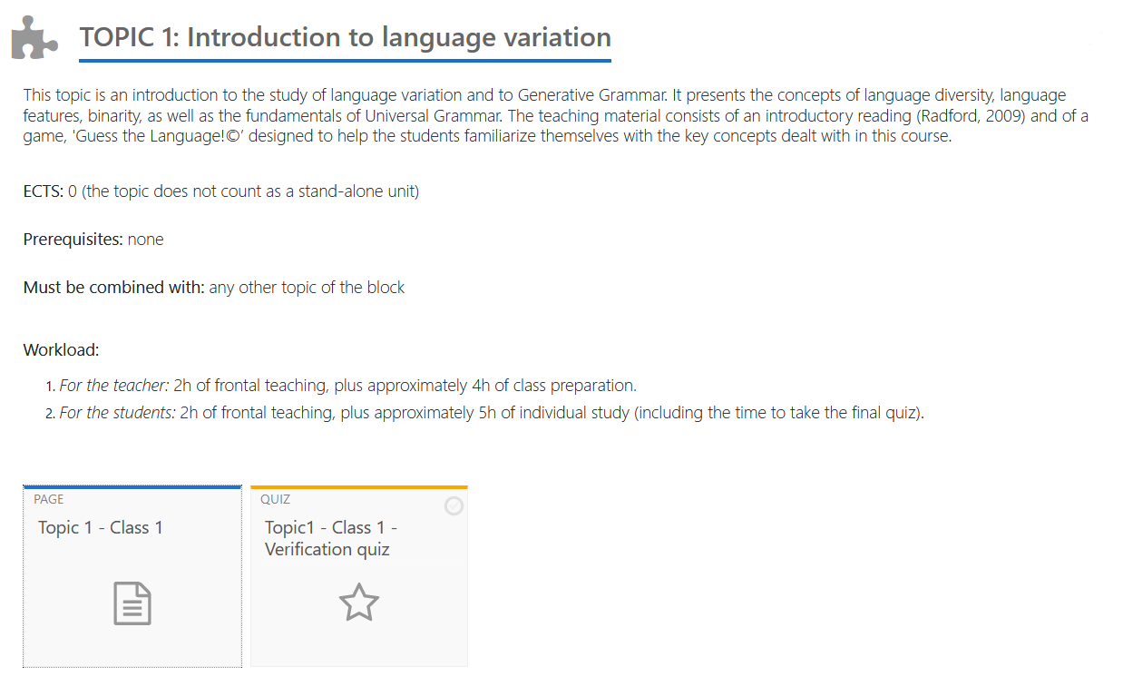

Slide 12
Structure of a topic
  Summary of the content
  Clear student/teacher workload
  Prerequisites
  Classes
  Revision activities
  Units can have a variable number of classes
  but the template used for each class is the same.
  Learning objectives
  Reading materials
  Guides for teachers
  In class activities
  Assessment

Slide 13
Topic 1 – Class 1
Learning Outcomes
Distinguish between deep and superficial features of languages
Provide examples of each type of feature
Provide examples of non-binary/binary linguistic features
Summarize the basic hypotheses behind the theory of Generative Grammar
1. In-class activity: "Break the ice with a guessing game"
2. In-class activity: "Hats & Eyes"

Slide 14
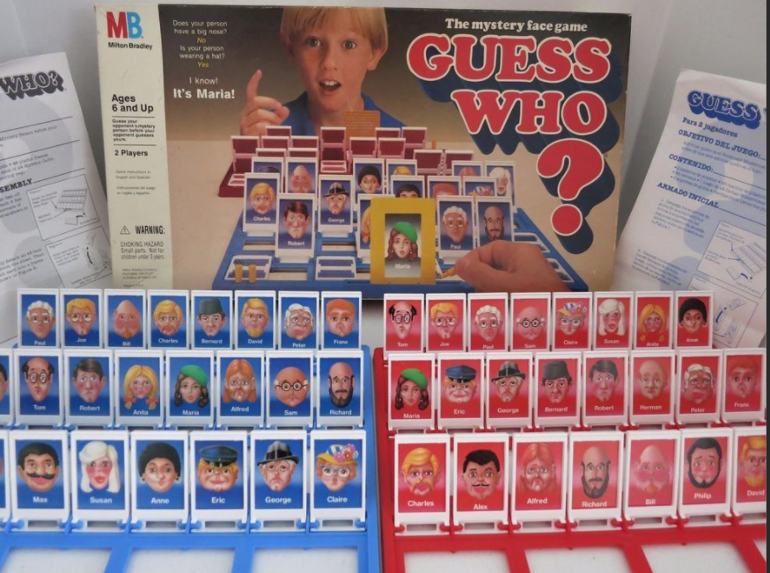

ORA and THEO Coster, 1979

Slide 15
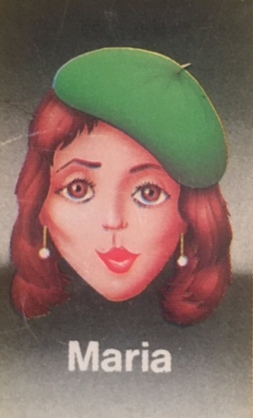
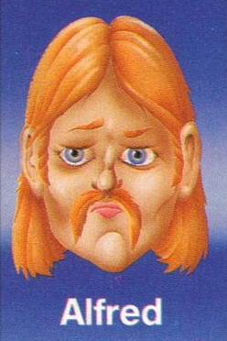

Slide 16
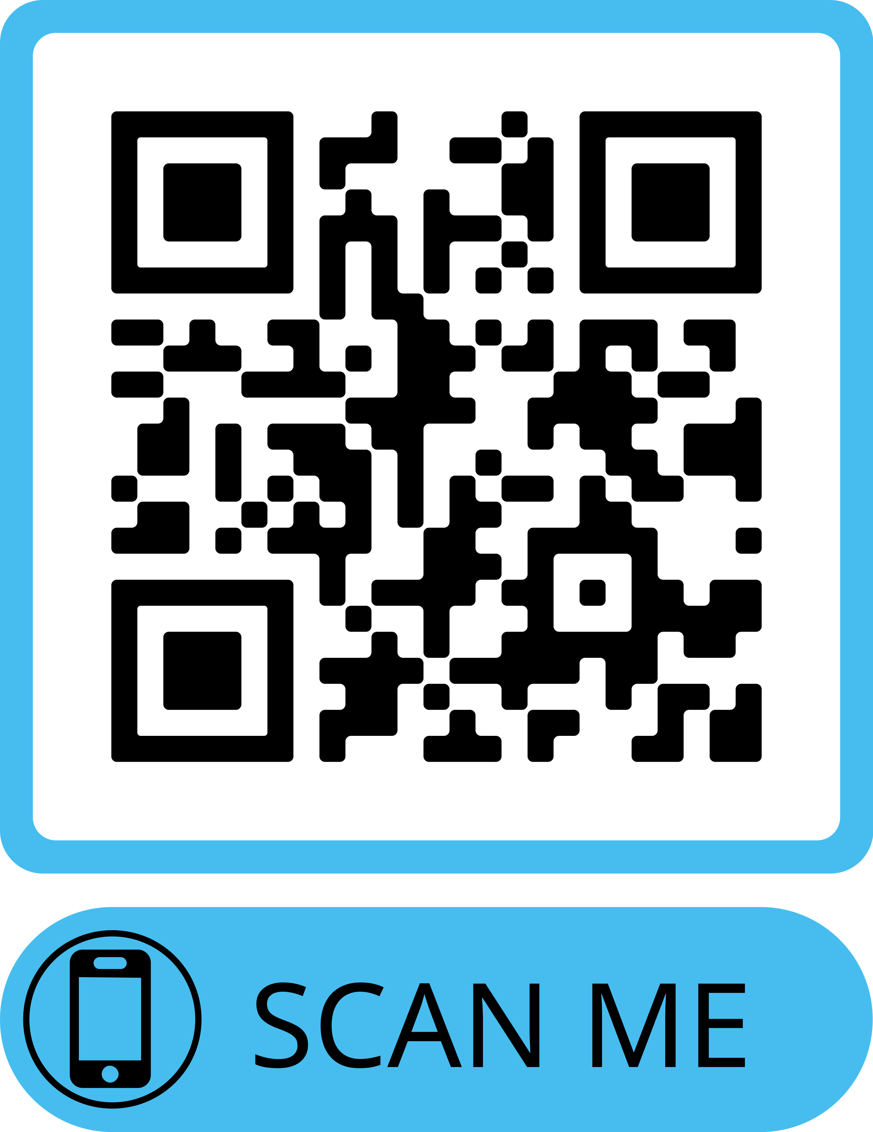
Guess the language!

Slide 17
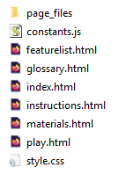
GamePack.zip

