Slide 1
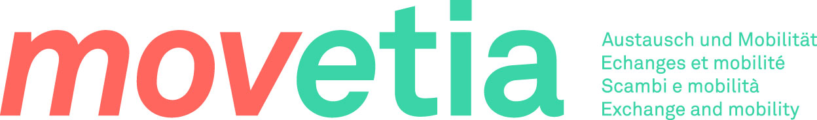
Start programming with Python in 10 steps

Slide 2
Presentation plan
Introduction, reasoning, goals
How to use the guide
The structure of a step
Brief overview of all steps

Slide 3
Introduction, reasoning, goals
Goal : acquiring basic knowledge of Python programming
Not a course, but a guide!
  aggregates carefully curated (correct, well-made, easy to understand) resources
  complements them with links and tips

Slide 4
How to use the guide
Intended for supervised learning
  Students 80%
  Teachers 20% (provide answers to some exercises + answers to questions)
10 steps covering 10 topics, building on each other, of various lengths
for a total of 5 ECTS

Slide 5
Structure of a step
Introduction: What is the topic? Why is it relevant?
“Things to know”
Learn actively: External resources, connected in a way that makes sense

Slide 6
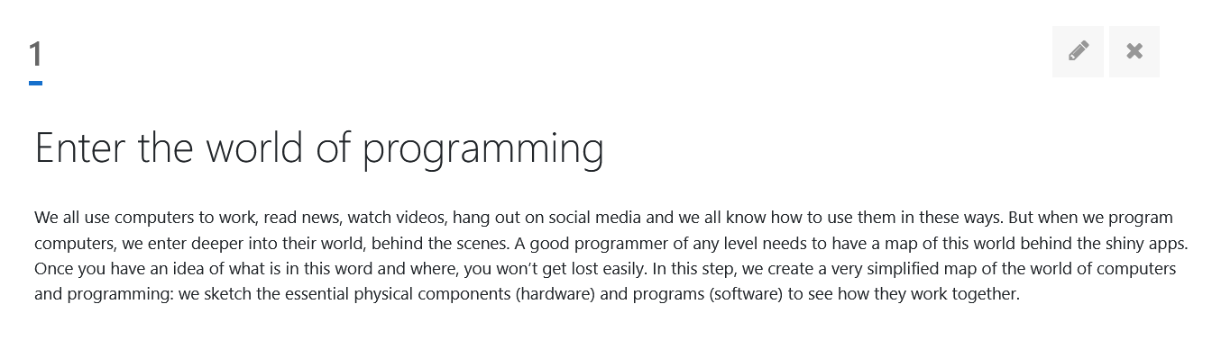
Structure of a step - Introduction

Slide 7
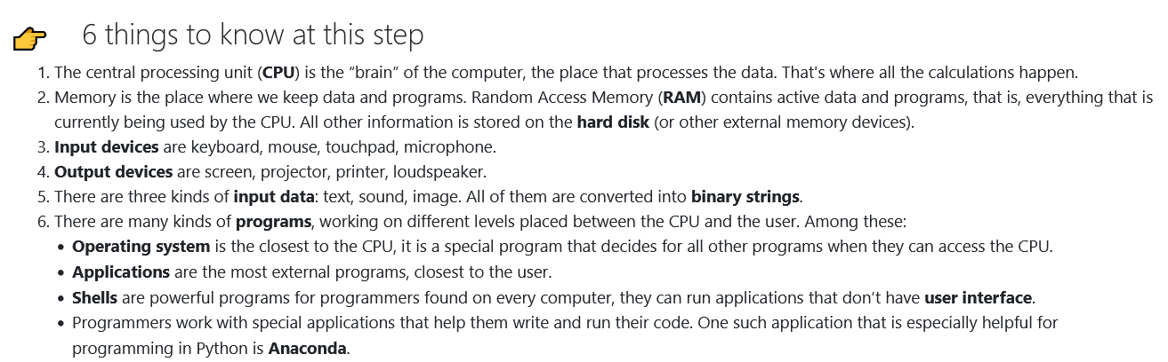
Structure of a step - Things to know

Slide 8
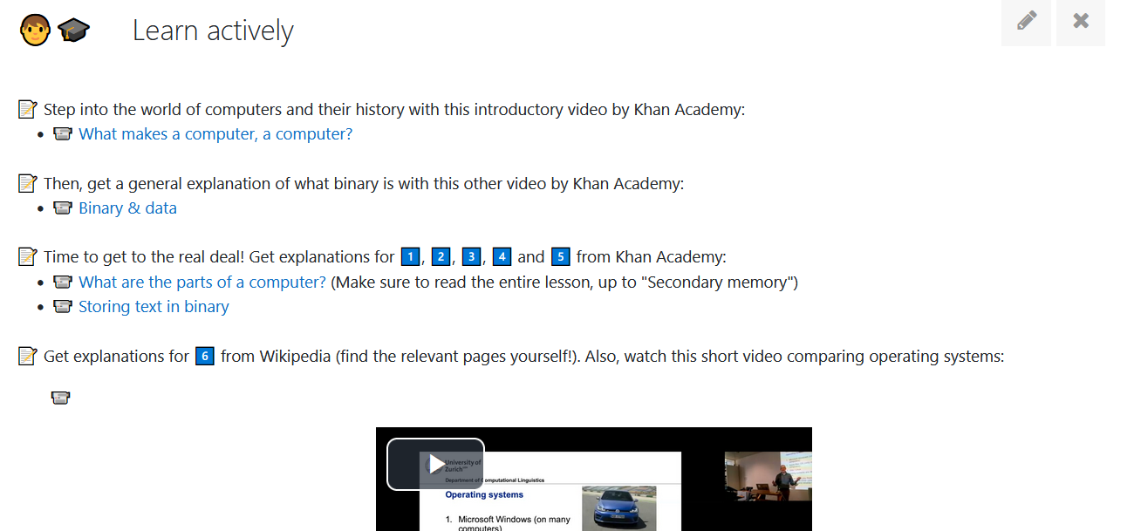
Structure of a step - Learn actively

Slide 9
Intended workflow
Introduction
Things to know
Learn actively

Slide 10
Brief overview of all steps (1)
Step 1: Enter the world of programming
Step 2: Watch Python code demo
Step 3: Write and run your first programs
Step 4: Figure out some details
Step 5: Get out of your notebooks

Slide 11
Brief overview of all steps (2)
Step 6: Start matching with regular expressions
Step 7: Grow your dictionaries
Step 8: Web is the limit
Step 9: Organise your code with functions and classes
Step 10: Contribute your code

Slide 12
Brought to you by
Tanja Samardžić
Marie Berthouzoz
Leo Ting Pan
Marc Tanti
Lonneke Van der Plas
Thank you!

